Slide 1
ITSA線上程式競賽基礎題目
#31~35

Slide 2
題目31. 過半元素
https://e-tutor.itsa.org.tw/e-Tutor/mod/programming/view.php?id=30781
運算思維: (課堂講解)
程式碼說明: (課堂講解)

Slide 3
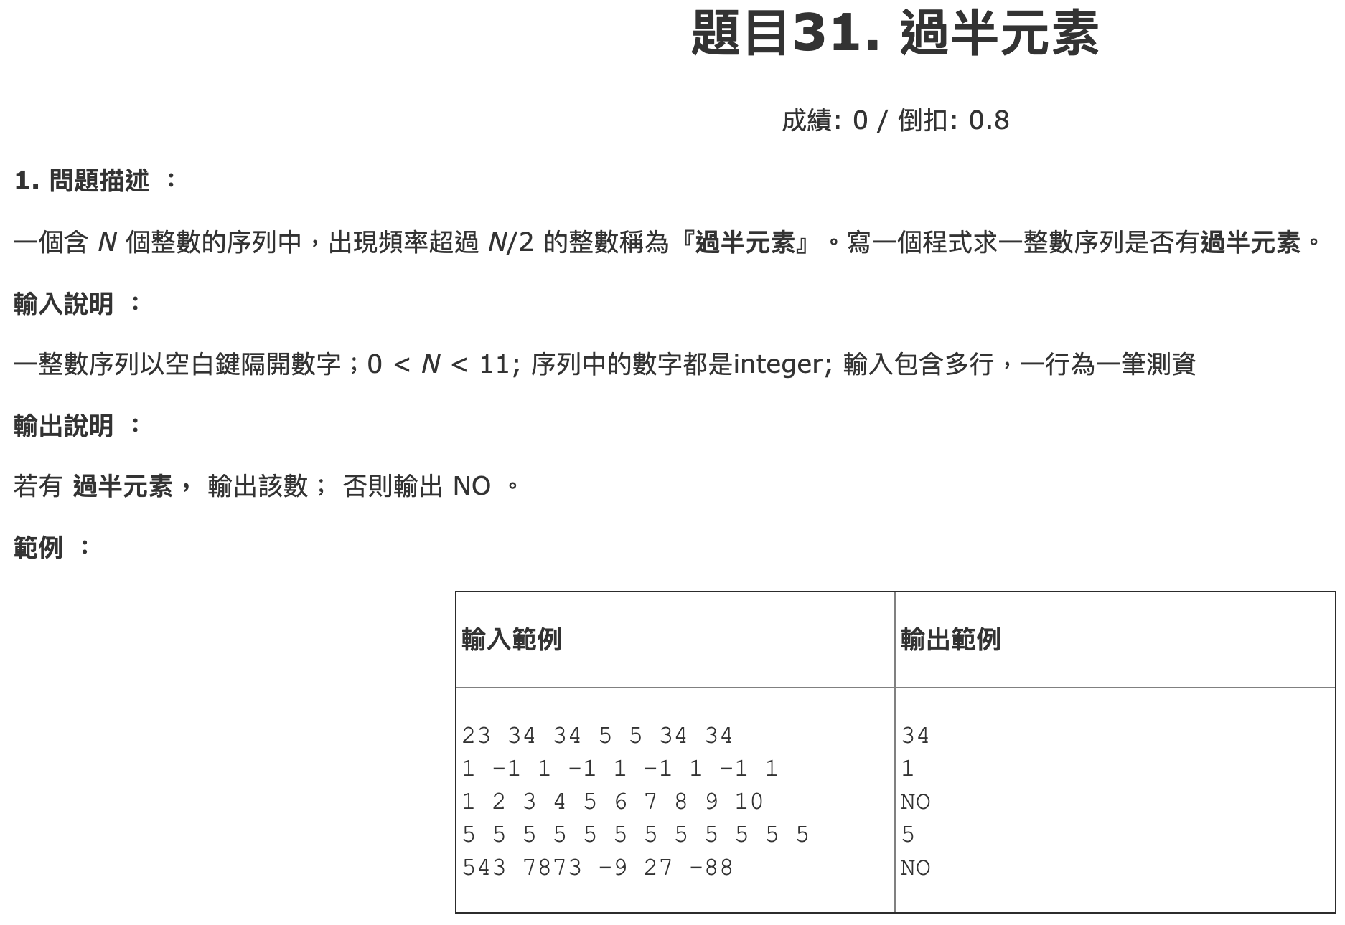

Slide 4
while True:
try:
nums = list(map(int, input().strip().split()))
for n in set(nums):
if nums.count(n) > len(nums) // 2:
print(n)
break
else:
print('NO')
except:
break

Slide 5
題目32. 字母往後移
https://e-tutor.itsa.org.tw/e-Tutor/mod/programming/view.php?id=30782
運算思維: (課堂講解)
程式碼說明: (課堂講解)

Slide 6
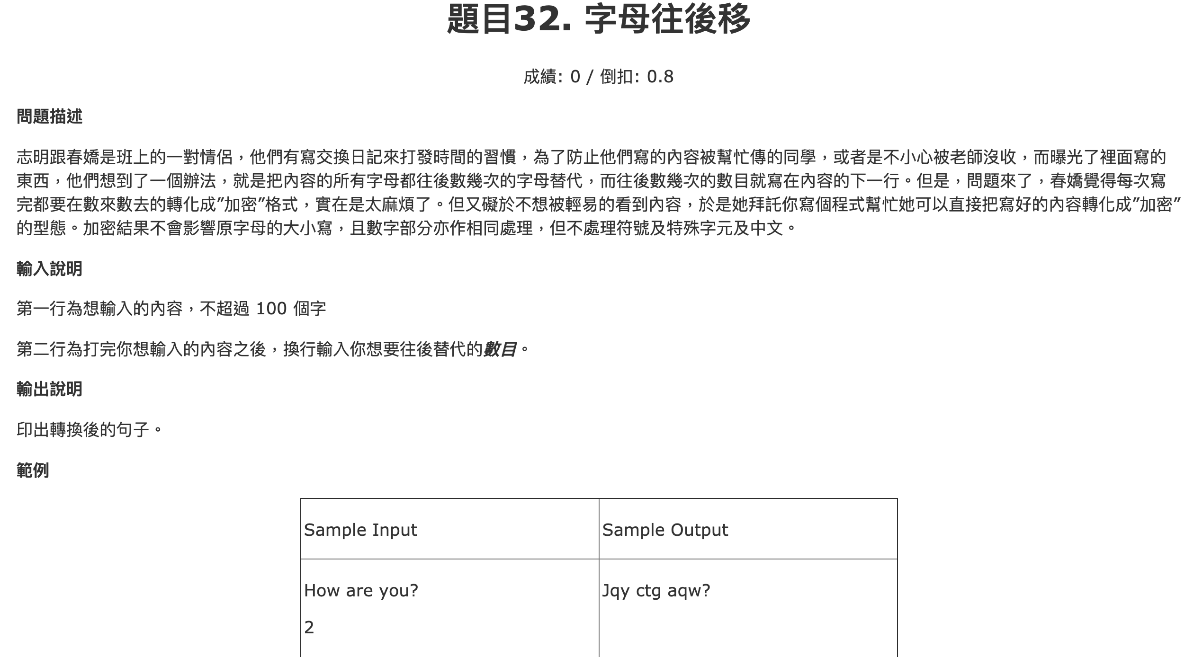

Slide 7
while True:
try:
S = list(input())
n = int(input())
res = ''
for c in S:
if c.isalpha():
if c.islower():
res += chr((ord(c) - ord('a') + n) % 26 + ord('a'))
else:
res += chr((ord(c) - ord('A') + n) % 26 + ord('A'))
elif c.isdigit():
res += chr((ord(c) - ord('0') + n) % 10 + ord('0'))
else:
res += c
print(res)
except:
break

Slide 8
題目33. 一整數序列所含之整數個數及平均值
https://e-tutor.itsa.org.tw/e-Tutor/mod/programming/view.php?id=30791
運算思維: (課堂講解)
程式碼說明: (課堂講解)

Slide 9
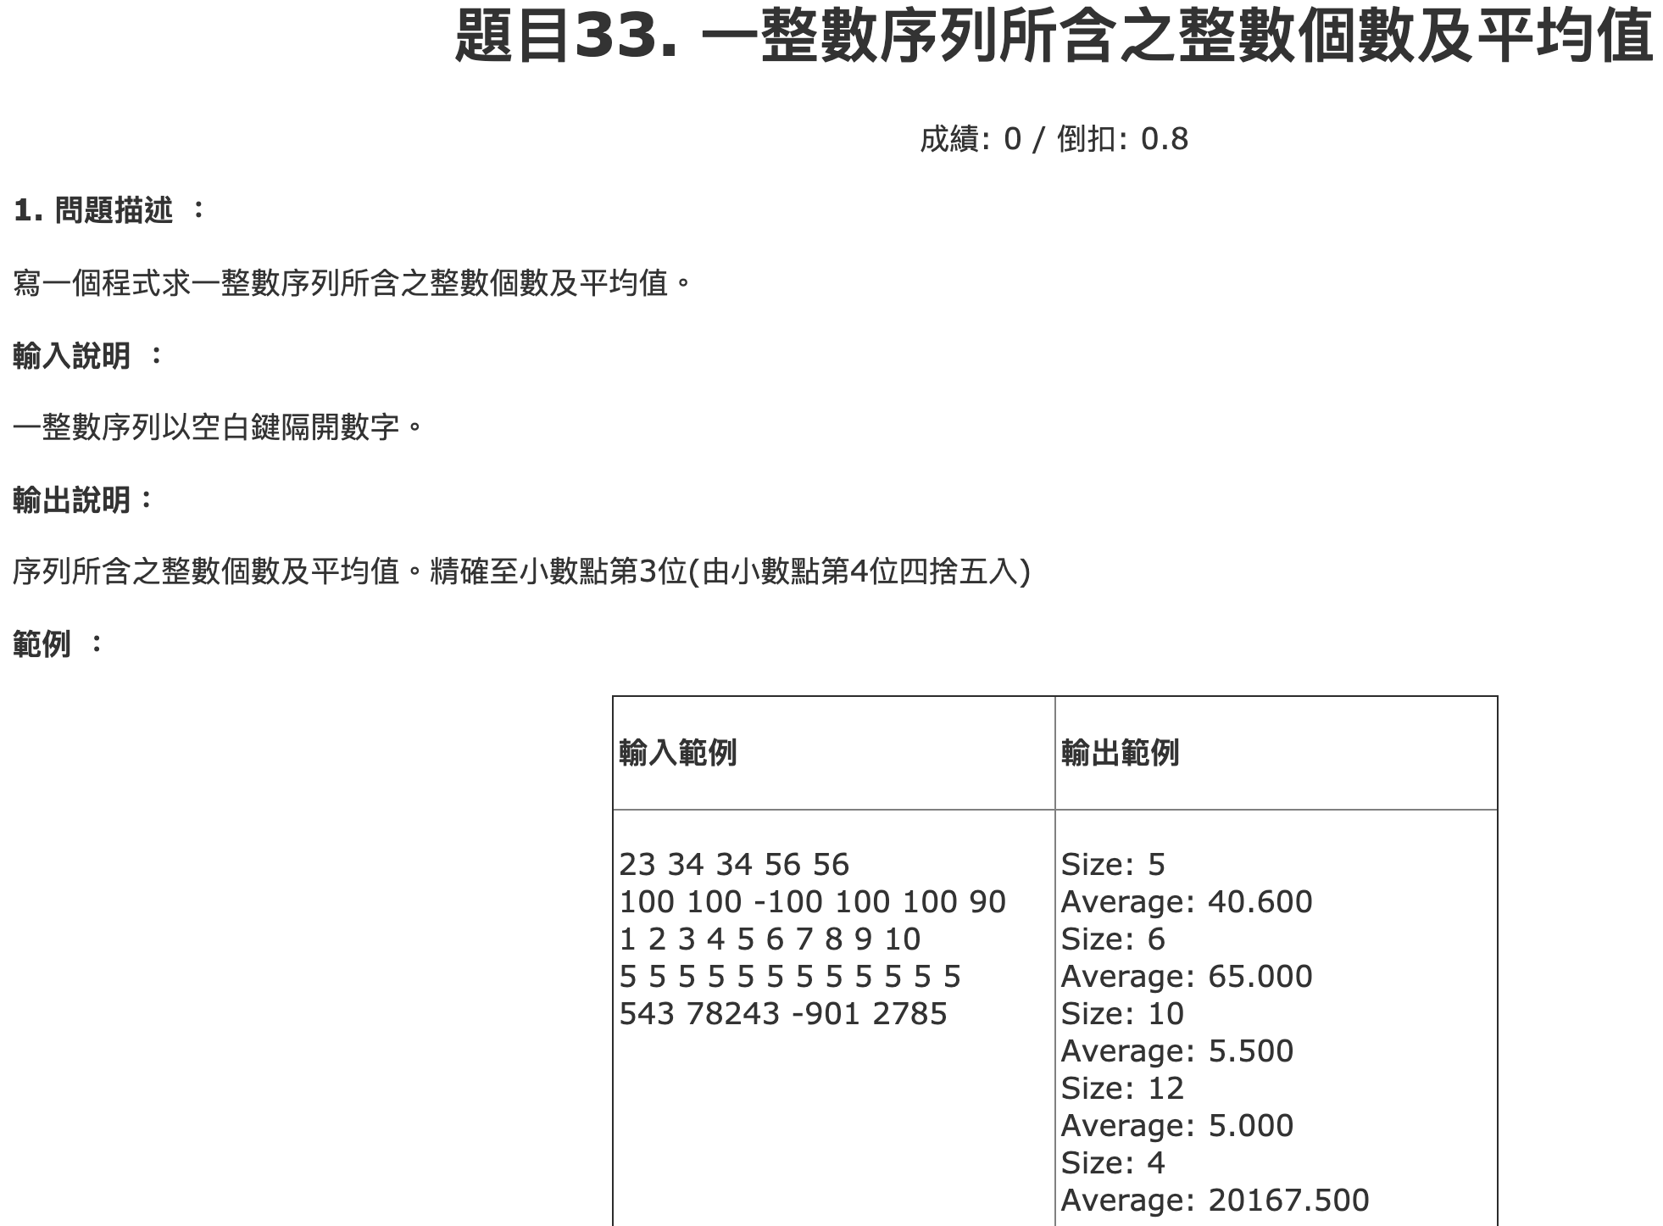

Slide 10
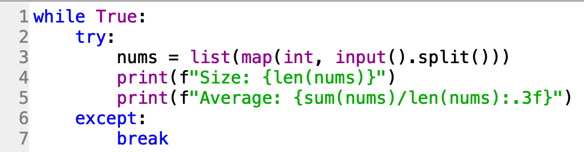

Slide 11
題目34. 標準體重計算
https://e-tutor.itsa.org.tw/e-Tutor/mod/programming/view.php?id=30792
運算思維: (課堂講解)
程式碼說明: (課堂講解)

Slide 12
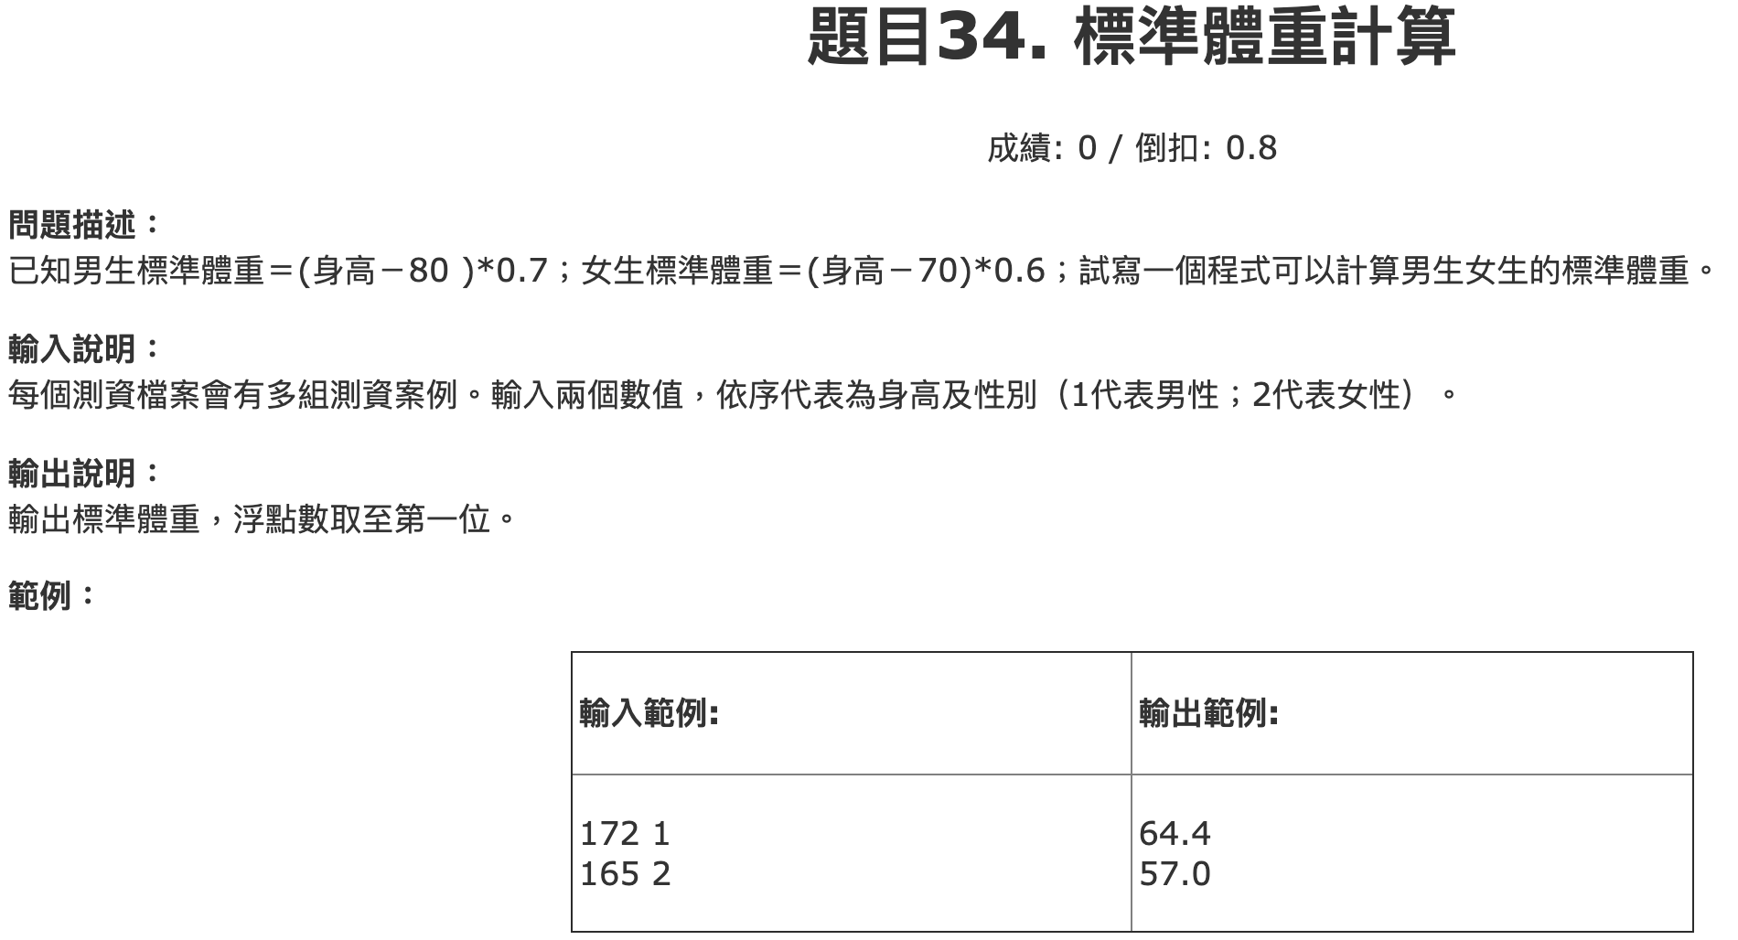

Slide 13
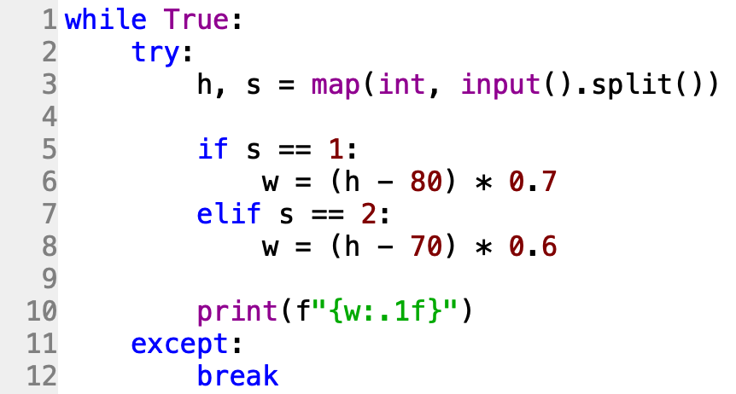

Slide 14
題目35. 買獎品
https://e-tutor.itsa.org.tw/e-Tutor/mod/programming/view.php?id=30793
運算思維: (課堂講解)
程式碼說明: (課堂講解)

Slide 15
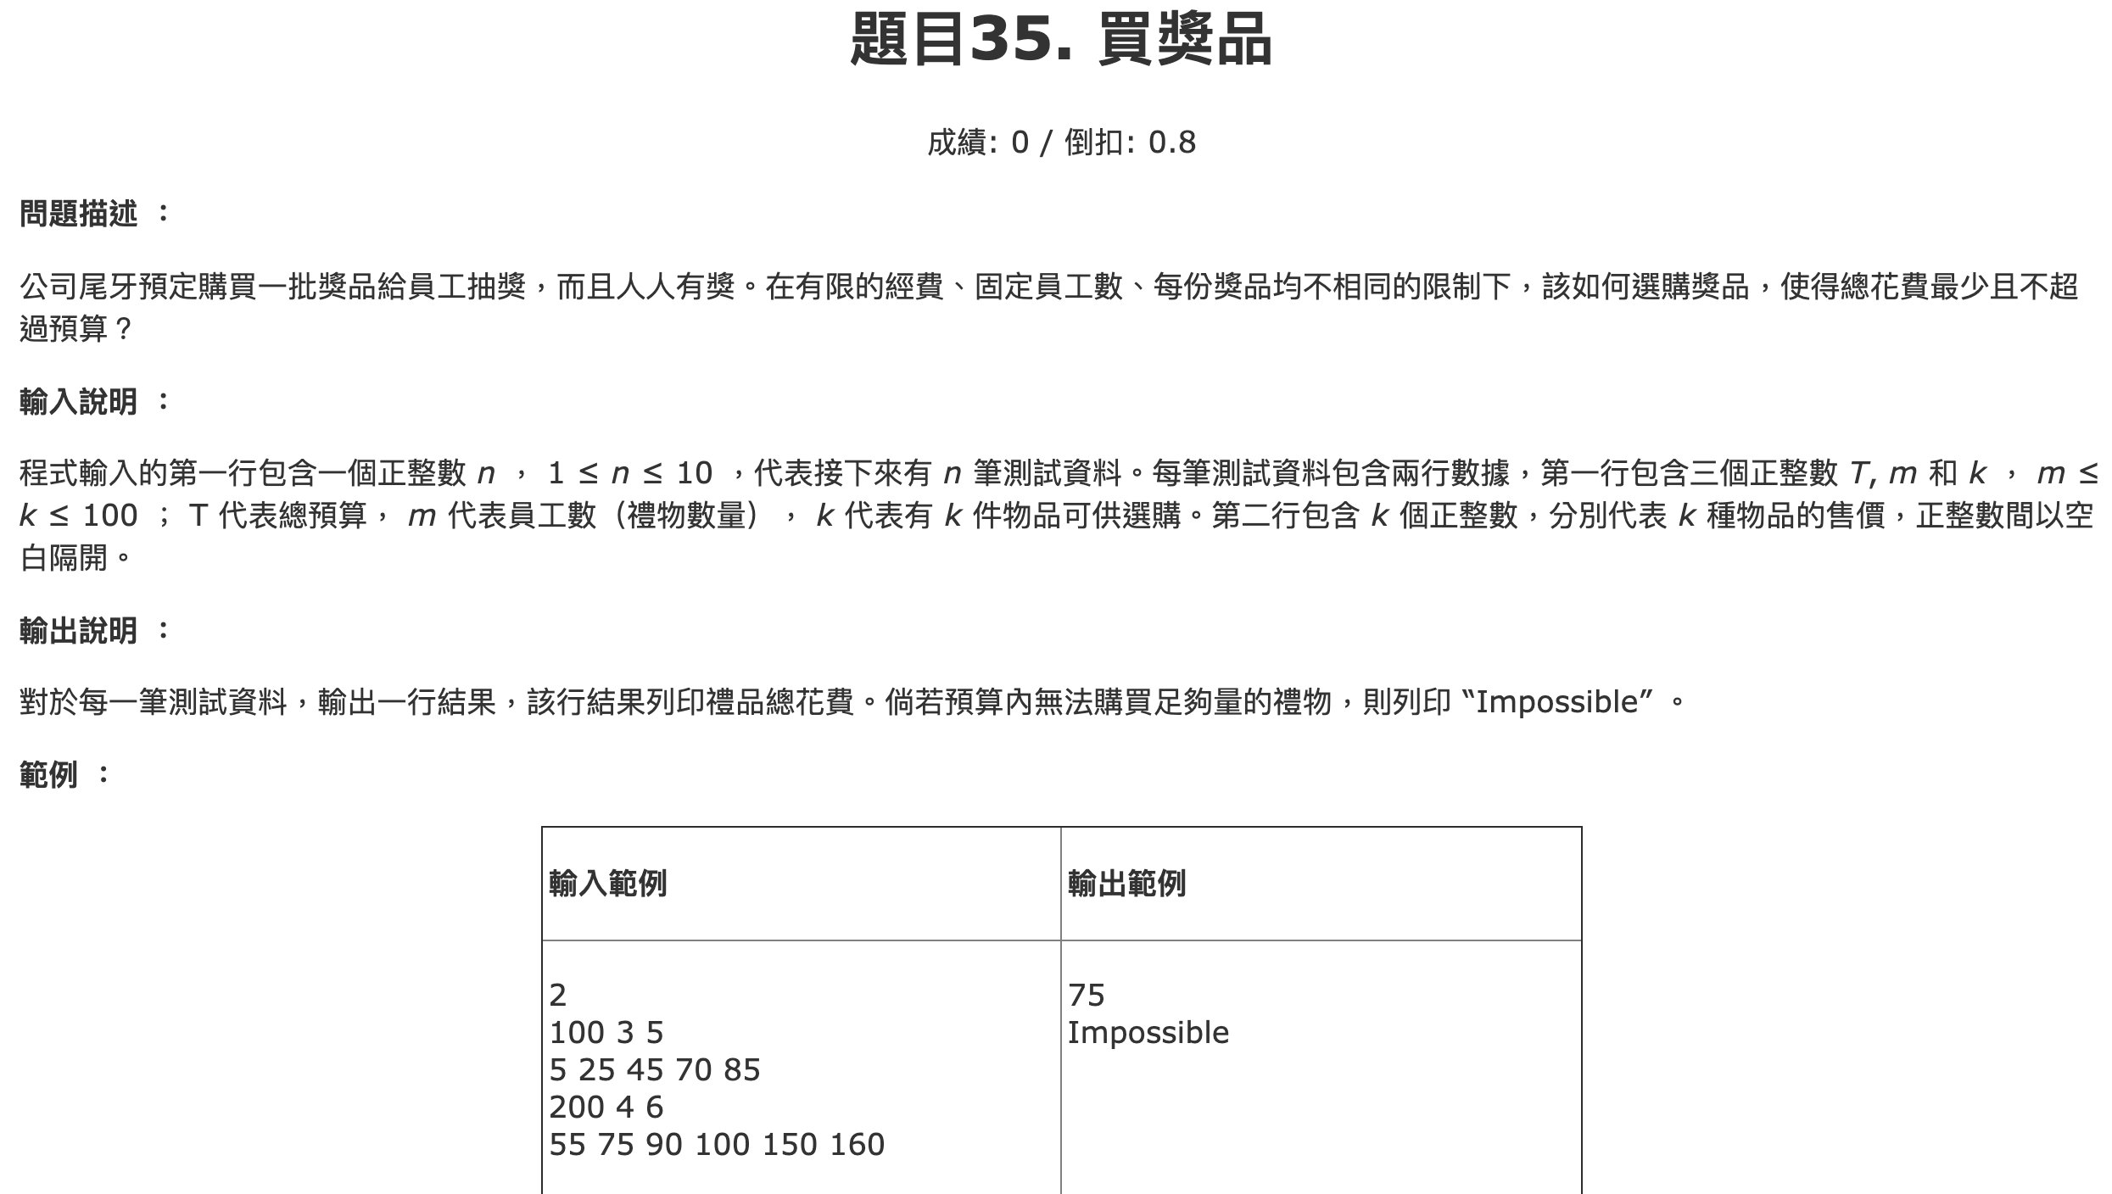

Slide 16
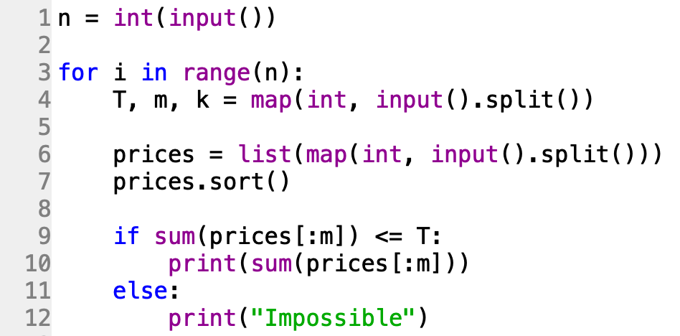

Slide 17
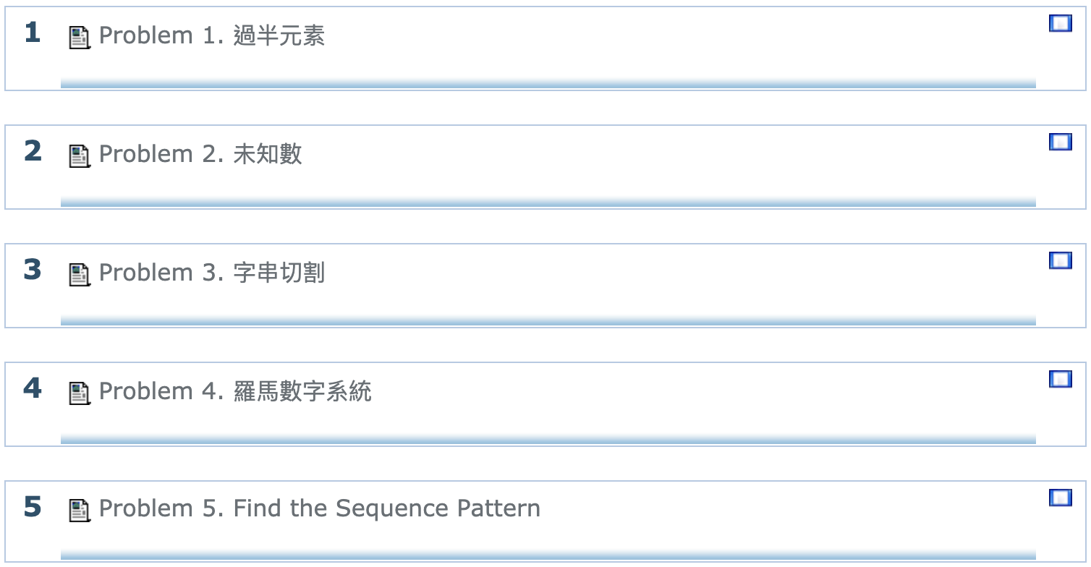
ITSA #66
https://e-tutor.itsa.org.tw/e-Tutor/course/view.php?id=1963

